Slide 1
PALLET SCAN AND PRINT PROJECT PRESENTATION
Pandele Daniel

Slide 2





OLD PROCESS VERSUS NEW PROCESS
Old process problems:
Slow :
The process involved the operator look for the label in the wrapped pallet.
Can cause errors:
The wrong label could be placed on the pallet.

Slide 3

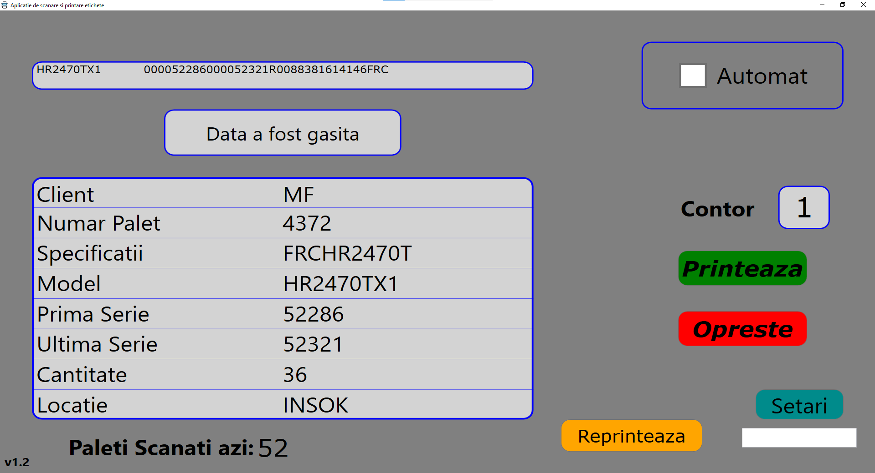
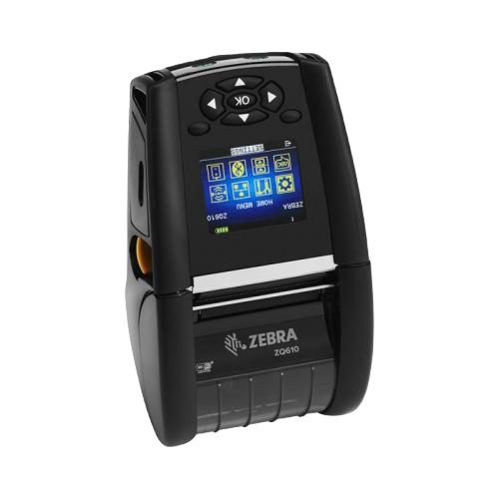
OLD PROCESS VERSUS NEW PROCESS
New system solutions:
Speed up the process by eliminating the need to look for the label. Just scan and print.
Functions:
Display pallet information
Automatic printing with timer
Print history
Reprint function

Slide 4



OLD PROCESS VERSUS NEW PROCESS
New system solutions:
Poka yoke:
One pallet -> one label set.
Will print only one set of labels.
The user cannot mix up the pallets.
1x Pallet
1x Label set

Slide 5
Gain
Quality:
Cost:
Reduce mislabelling errors. This can cause the pallet to be shipped to the wrong customer
Save 20 seconds per pallet operation. With 500 pallets per day it equals ~ 60 hours per month.
Save 5 minutes per lost label. Around 5 labels per day lost it equals ~ 10 hours per month.

Slide 6

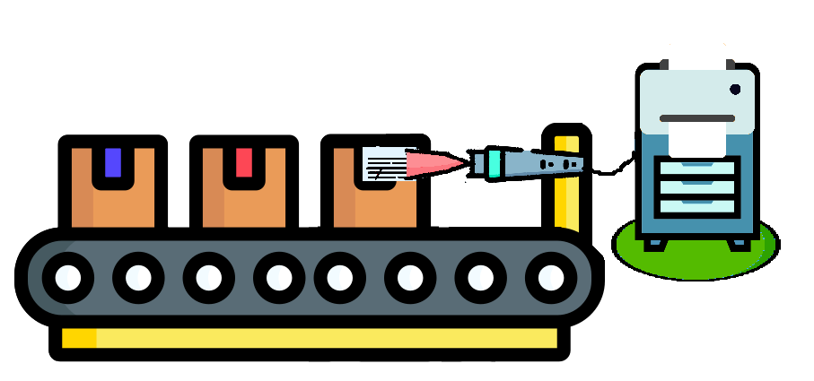

Future steps:
-Automatization:
Replace two operators in the process with a machine in order to minimize error frequency reduce expenses and gain more time
-Reduction of man power
-Further reduction of process time

Slide 7
THANK YOU FOR YOUR ATTENTION

